Slide 1
Python Basics Series For Beginners video 6
String Manipulation

Slide 2
Index
What is string, how are they stored, indexing etc
Basic operation on Strings
Strings Functions and methods

Slide 3
What are Strings
A string is a sequence of characters.
A character is simply a symbol. For example, the English language has 26 characters.
Computers do not deal with characters, they deal with numbers (binary). Even though you may see characters on your screen, internally it is stored and manipulated as a combination of 0's and 1's.
This conversion of character to a number is called encoding, and the reverse process is decoding. ASCII and Unicode are some of the popular encoding used.
In Python, a string is a sequence of Unicode characters. Unicode was introduced to include every character in all languages and bring uniformity in encoding
‘ ’ , “ ” are used to define strings

Slide 4
Basic operation on String
+ operator
ex- ‘harshit’+’roy’ , ‘3’+2
output- ‘harshitroy’ , error
* operator
ex- ‘hr’*3 , ‘hr’*’hr’
output- ‘hrhrhr’ , error

Slide 5
In and not in operator
‘h’ in ‘harshit’ → True
‘h’ not in ‘harshit’ → False
Determine Unicode and ascii of character
ascii = ord(‘h’)
unicode = ord(u’h’)
ascii to character = chr(97)

Slide 6
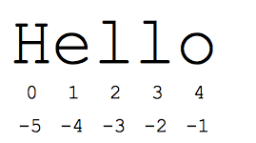
Accessing elements in string
Locating elements in sequence is called indexing
In strings we can do two way indexing
Forward indexing
backward indexing

Slide 7
String Slicing
Slicing means accessing a section of a sequence in this case string.
Syntax :-
string_name(character_from_left,character_from_right)

Slide 8
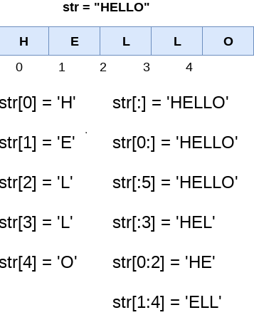

Slide 9
String Functions and methods
string.capitalize() : First character capitalized
ex - ‘I know python’.capitalize()
string.isalnum() : contains any alpha or num character
ex - ‘ ’.isalnum() → False
‘ab’.isalnum() → True
Similar are .isalpha() = only alphabets
.isdigit() = only numbers

Slide 10
string.isupper() & string.islower() : whether alphabet present is lower or upper.
ex - ‘123A’.isupper() → True
‘Hello’.isupper() → False
string.isspace() : whether that character is white space or not.
ex – ‘’.isspace() → False
‘ ’.isspace() → True
‘h r’.isspace() → False
‘ ’.isspace() → True

Slide 11
Functions you can check
string.lower() & string.upper()
string.lstrip()
string.rstrip()

